Slide 1
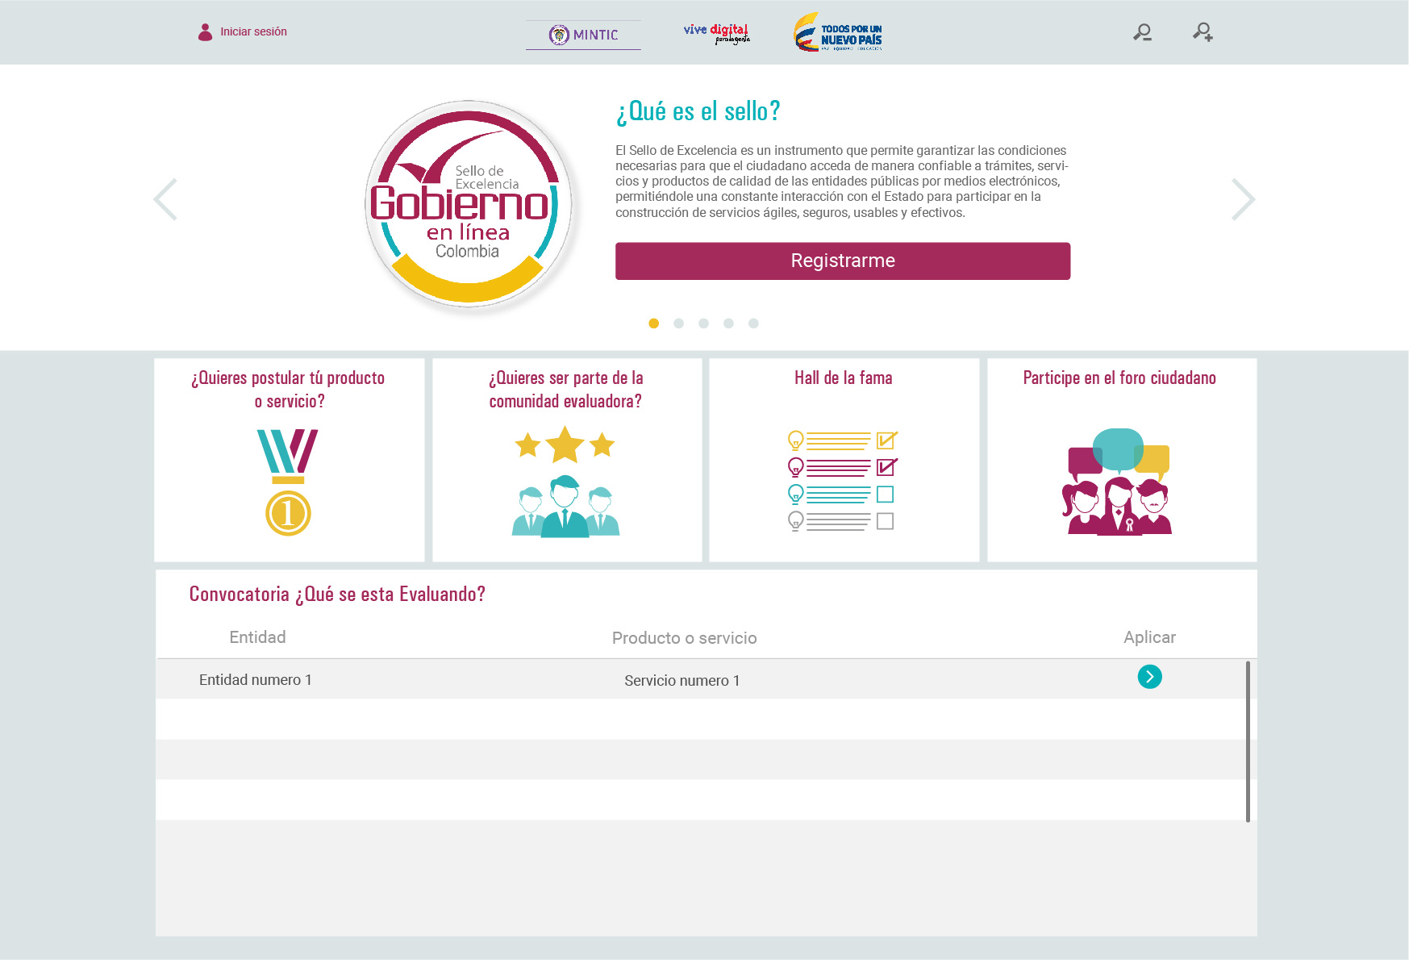
api/service/service?filter_field=current_status&filter_value=1

Slide 2
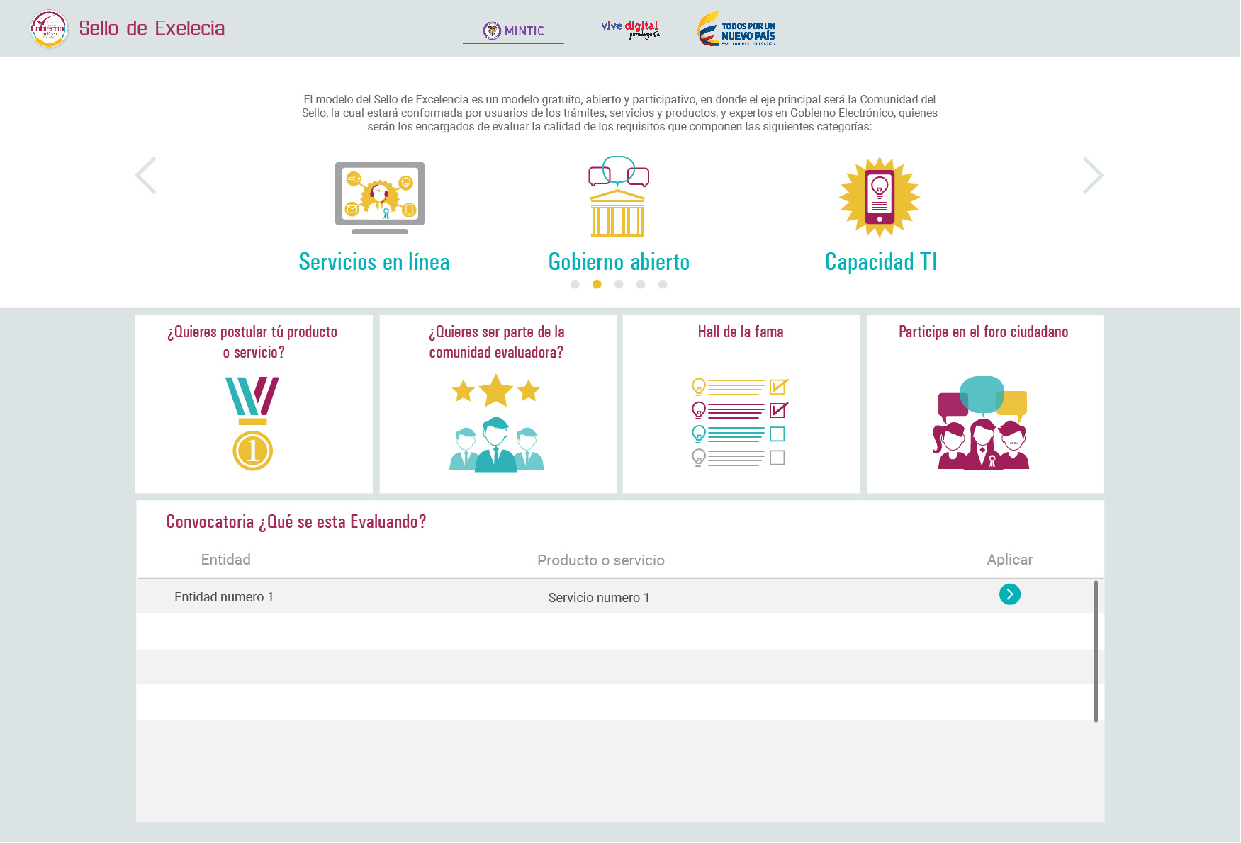
api/service/service?filter_field=current_status&filter_value=1

Slide 3
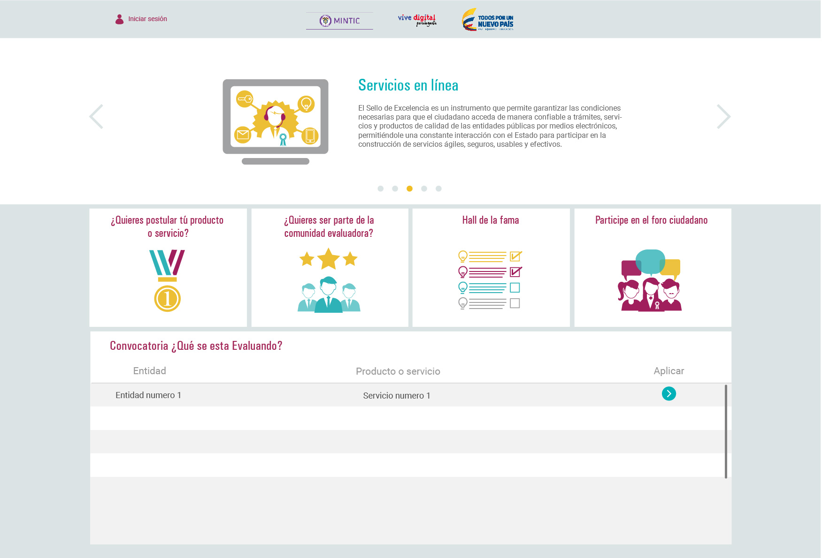
api/service/service?filter_field=current_status&filter_value=1

Slide 4
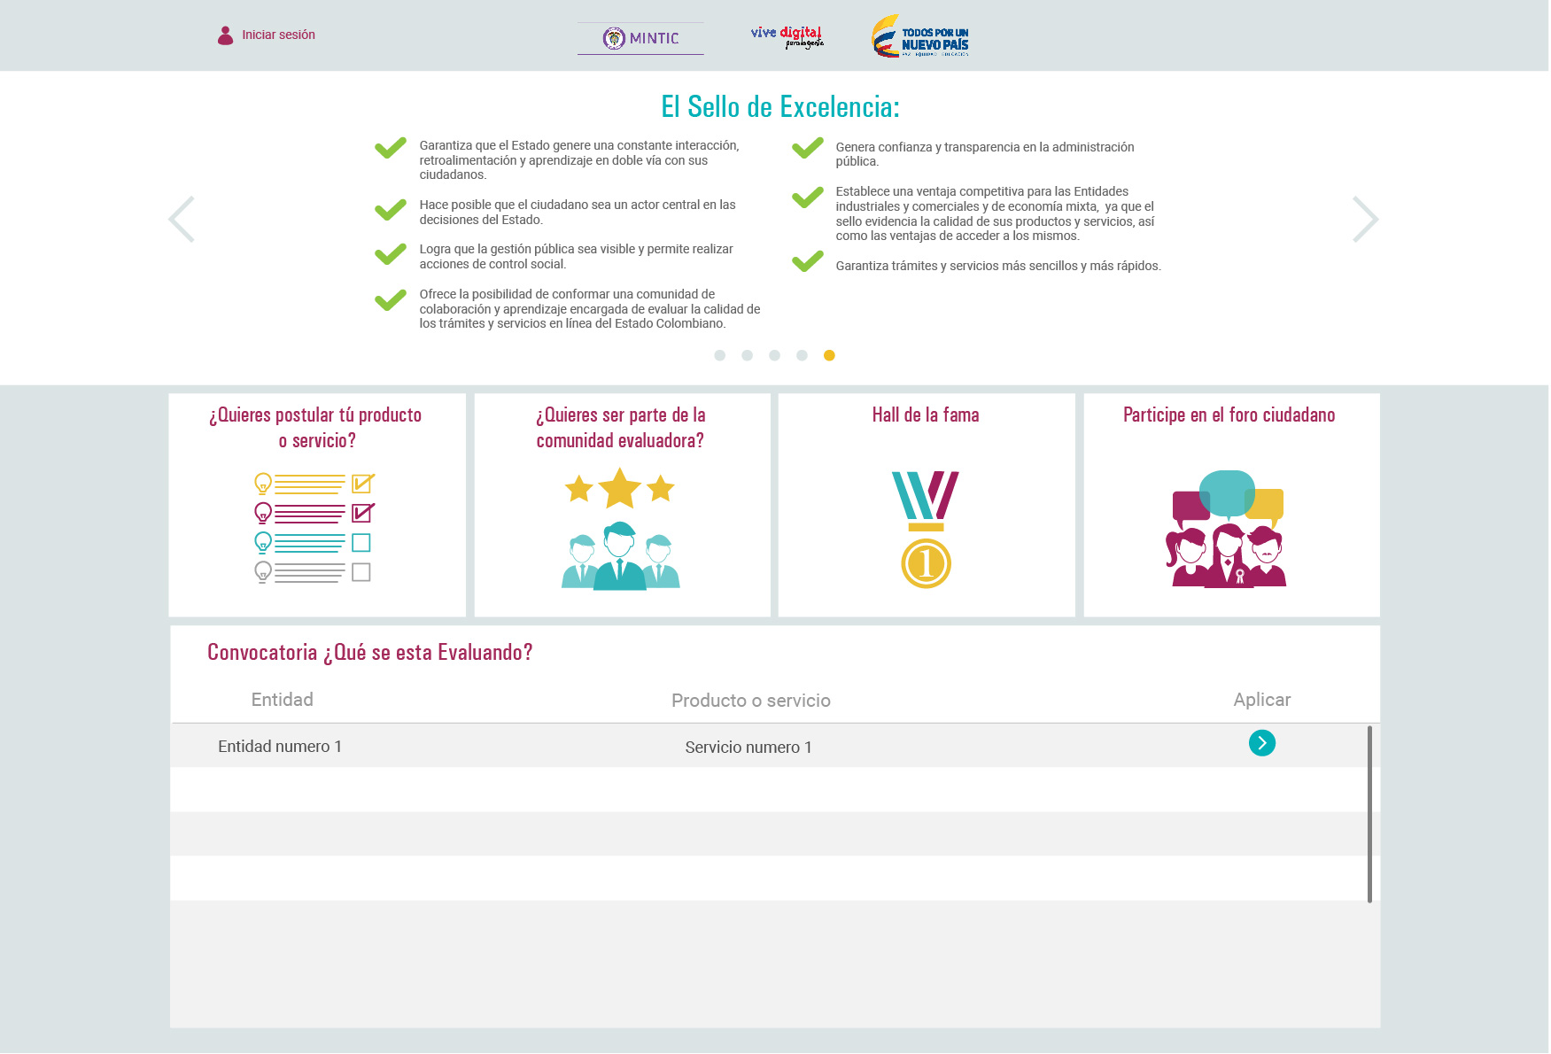
api/service/service?filter_field=current_status&filter_value=1

Slide 5
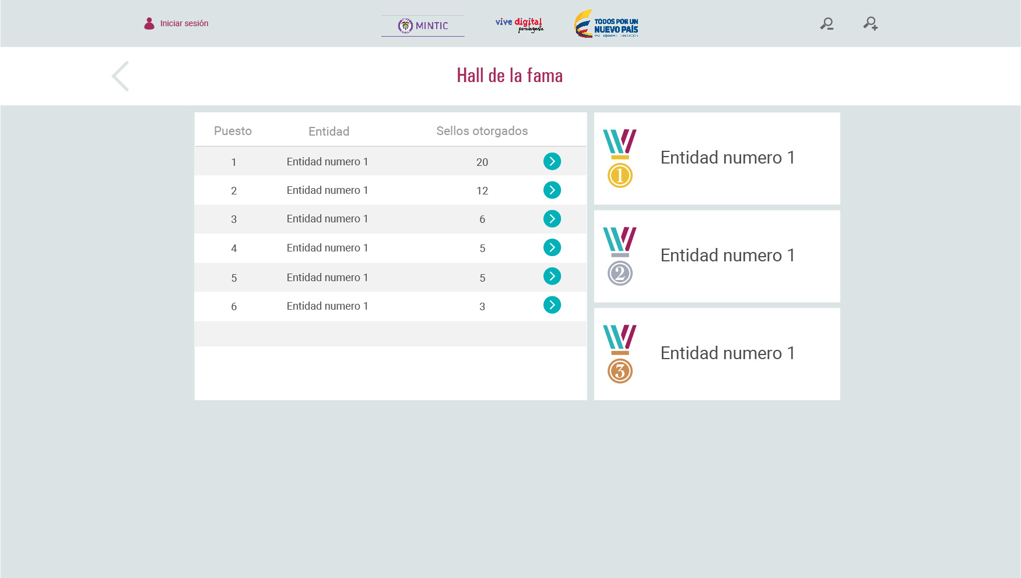
api/service/hall_fame

Slide 6
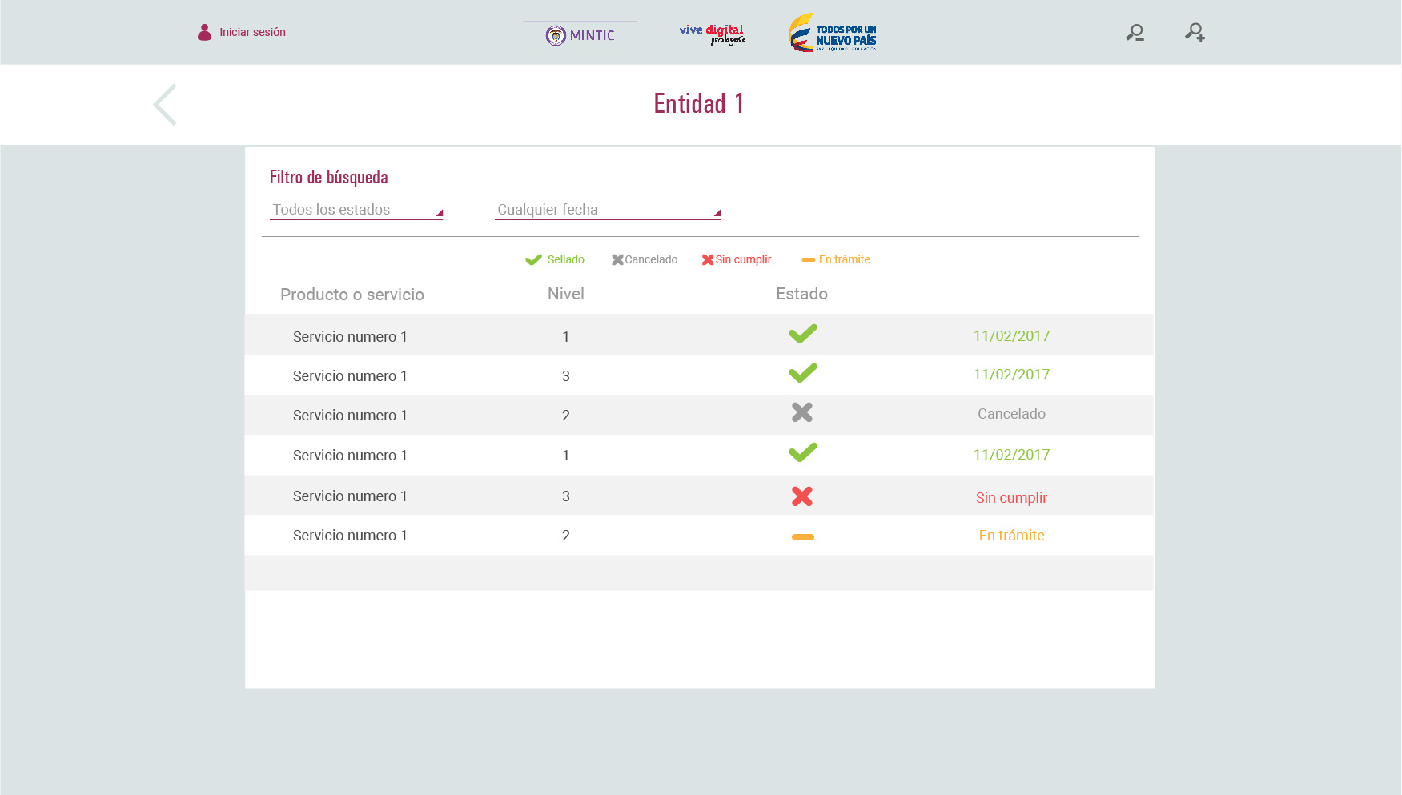
Current_status
Institution
api/service/service?filter_field=current_status&filter_field=id_institution&filter_value={{STATUS}}&filter_value={{INSTITUTION}}

Slide 7
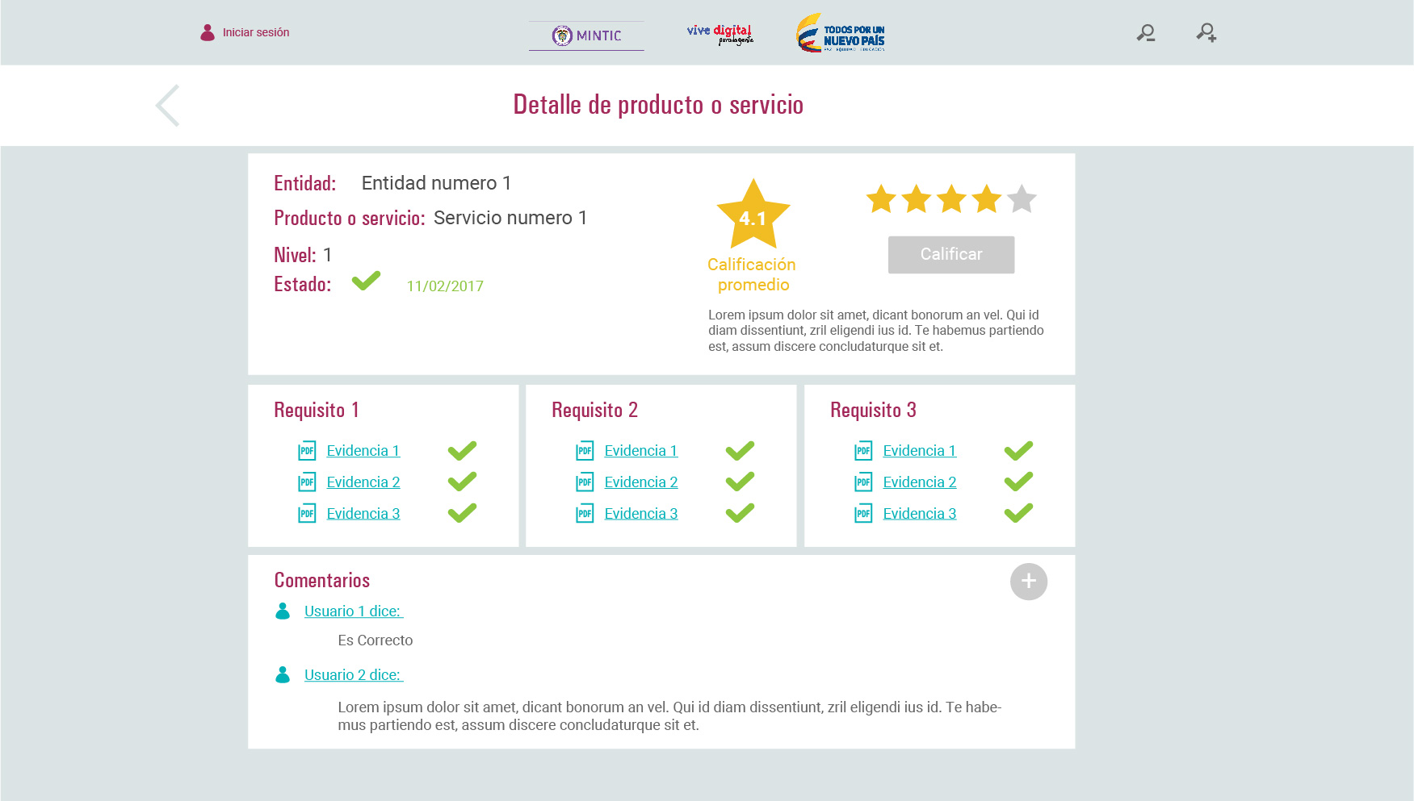
api/service/service?id={{SERVICE}}
rate
Current_status
Api/service/service_comment
{
id_service:{{SERVICE}}
id_user:{{USER}}
text:{{TEXT}}
rate:{{RATE}}
}
api/question/evaluation_request?filter_field=id_service&filter_value={{SERVICE}}
Comments

Slide 8
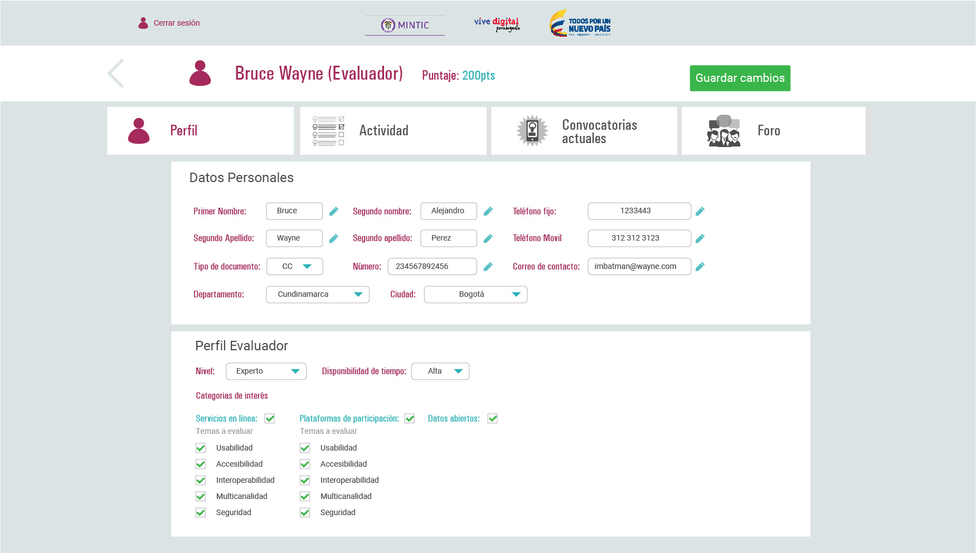
api/configuration/user?id={{USER}}
City
/api/places/region
Level
Availability
Categories
Topics

Slide 9
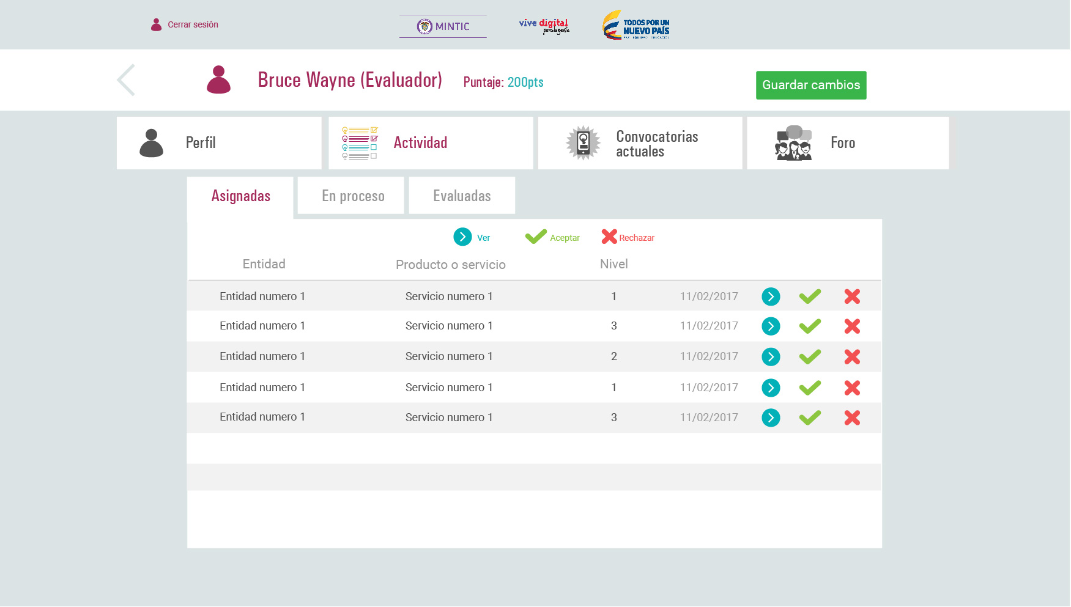
Status
api/question/evaluation_request?filter_field=id_user&filter_value={{USER}}&filter_field=id_request_status&filter_value=1

Slide 10
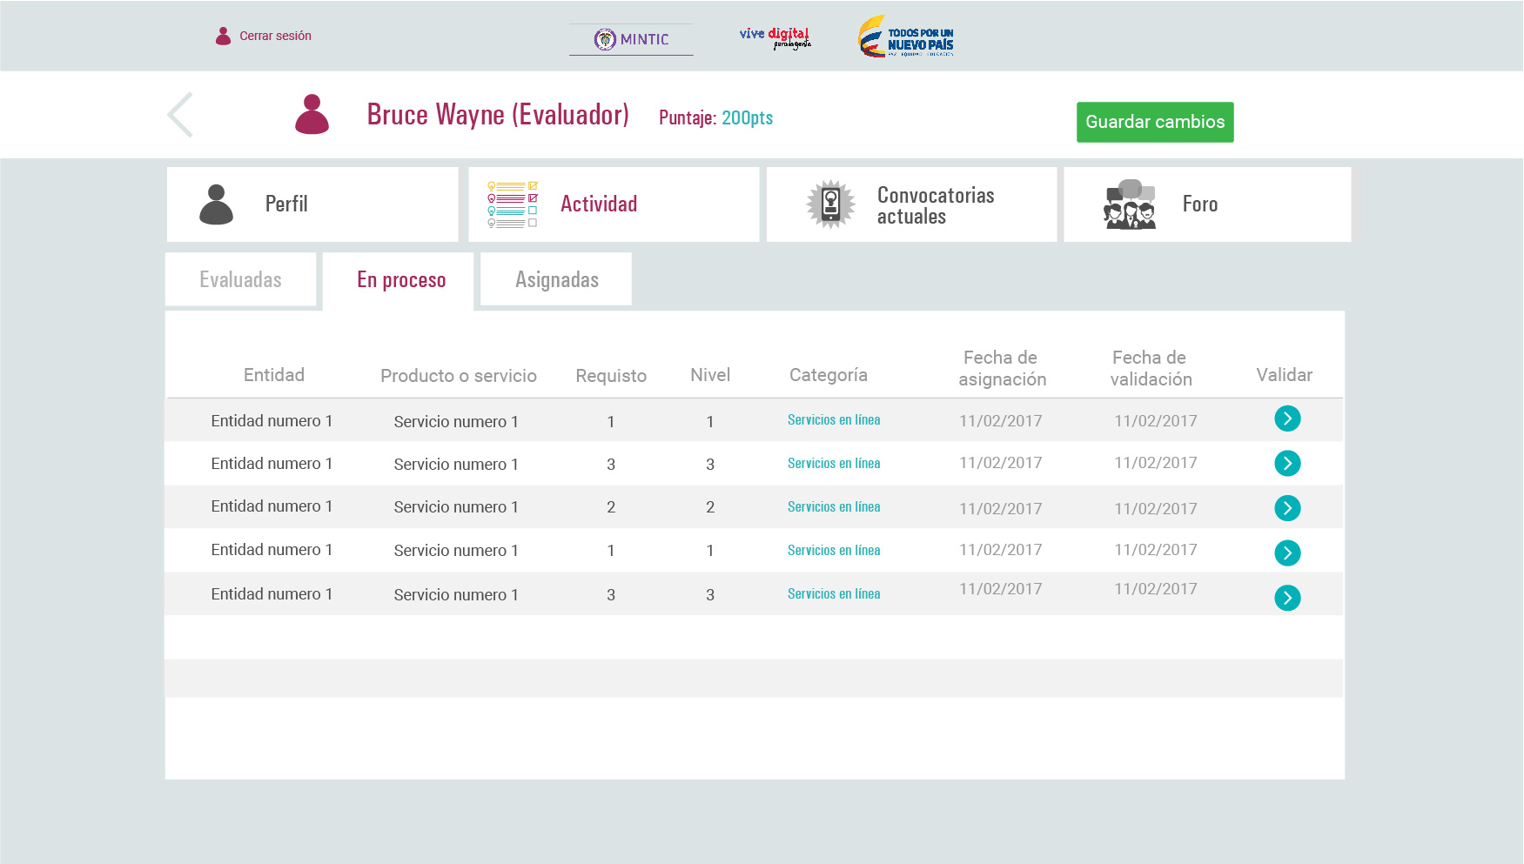
Status
api/question/evaluation_request?filter_field=id_user&filter_value={{USER}}&filter_field=id_request_status&filter_value=2

Slide 11
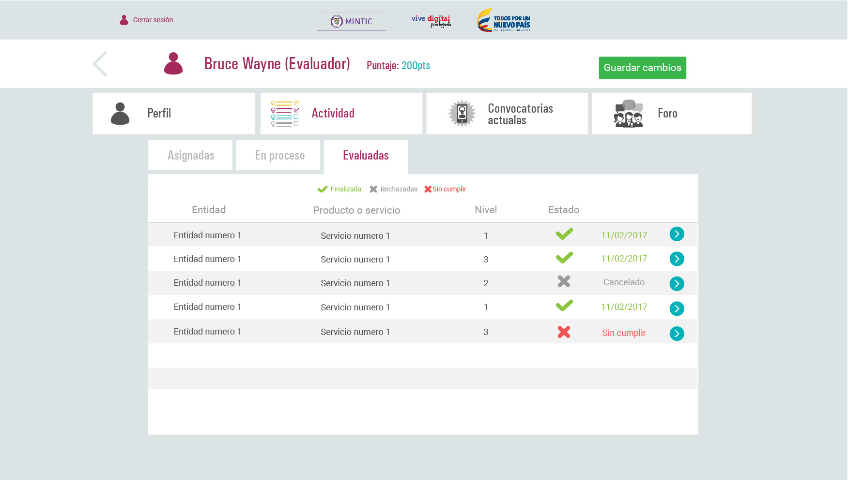
Status
api/question/evaluation_request?filter_field=id_user&filter_value={{USER}}&filter_field=id_request_status&filter_value=3

Slide 12
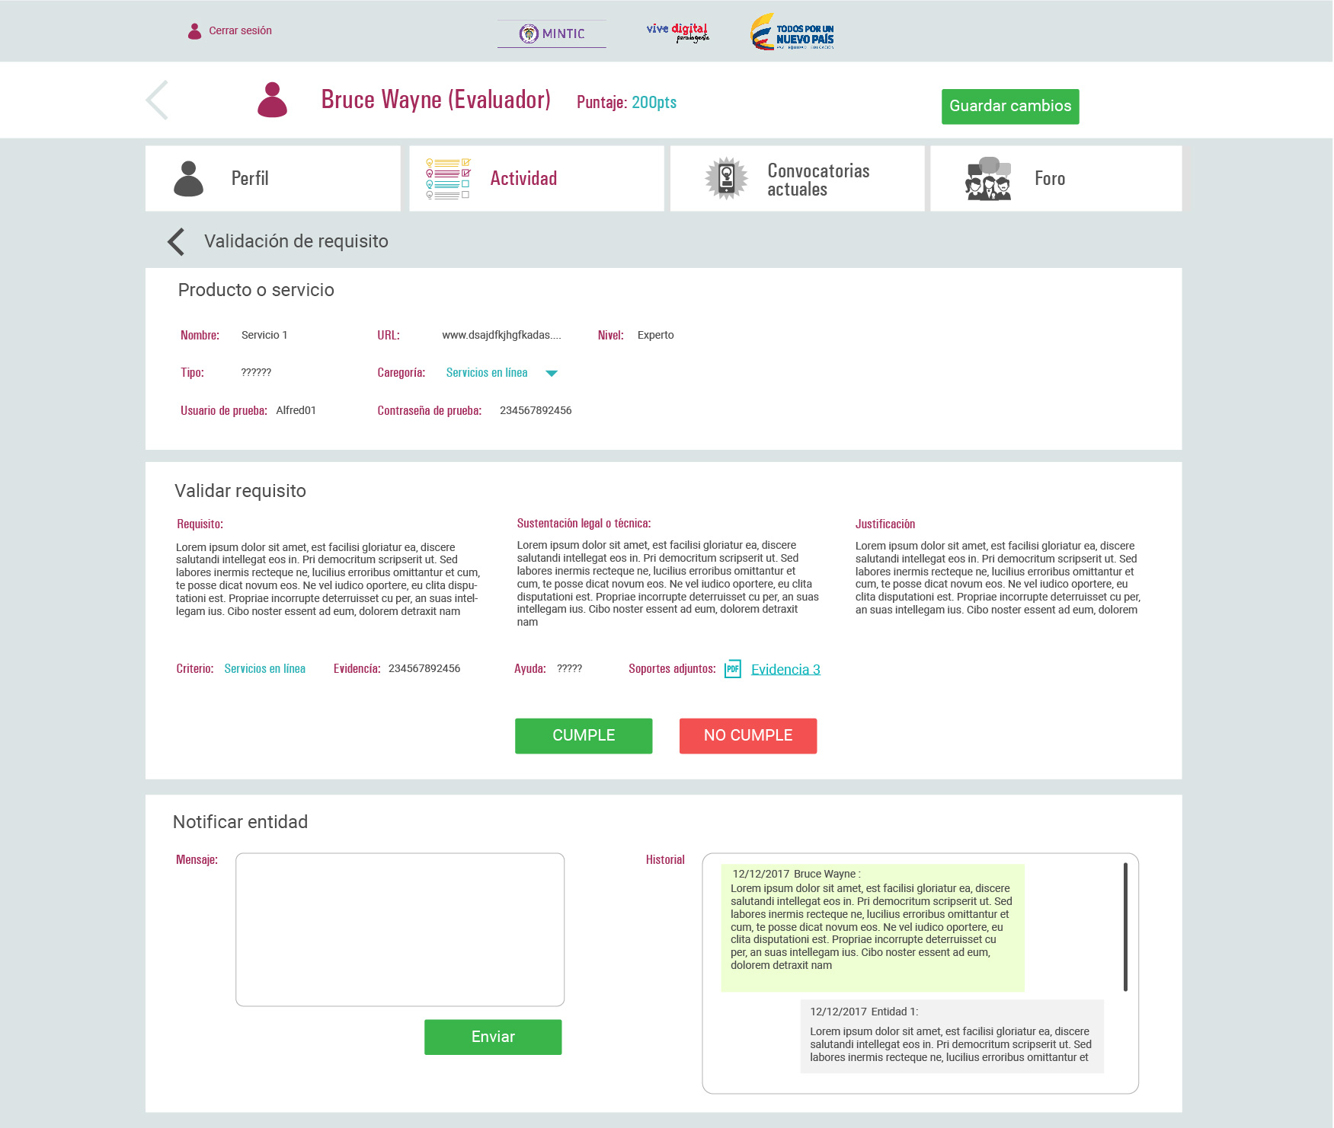
api/service/service?id={{SERVICE}}
api/question/evaluation_request?filter_field=id_service&filter_value={{SERVICE}}&filter_field=id_user&filter_value={{USER}}
Comments
api/service/service_comment

Slide 13
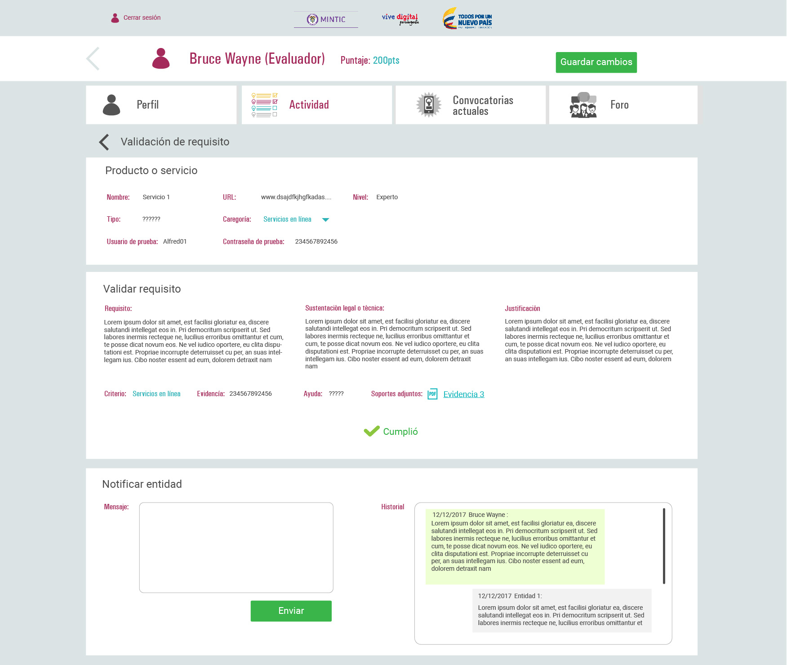
api/service/service?id={{SERVICE}}
api/question/evaluation_request?filter_field=id_service&filter_value={{SERVICE}}&filter_field=id_user&filter_value={{USER}}
Comments
api/service/service_comment

Slide 14
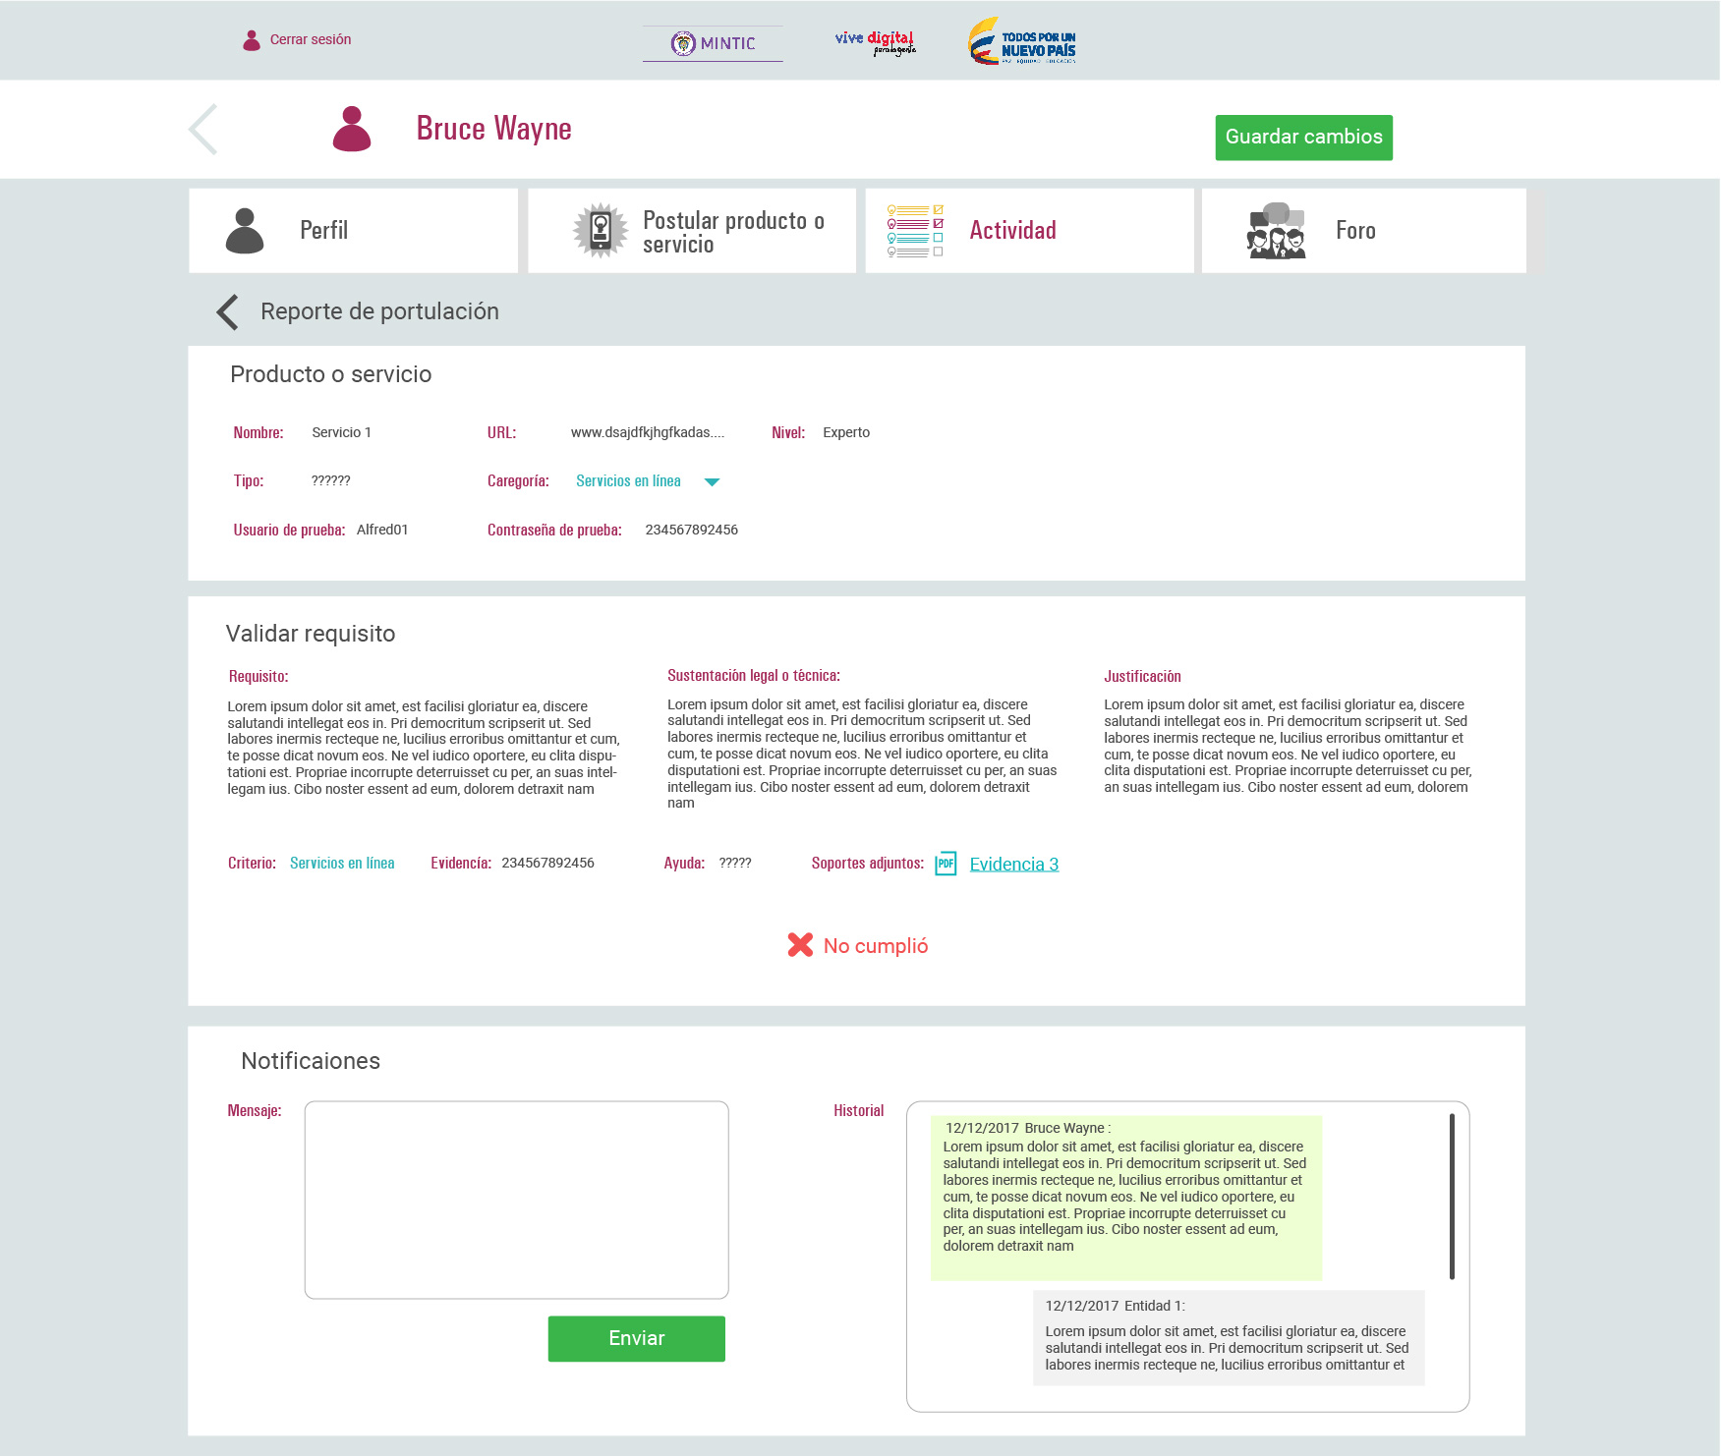
api/service/service?id={{SERVICE}}
api/question/evaluation_request?filter_field=id_service&filter_value={{SERVICE}}&filter_field=id_user&filter_value={{USER}}
Comments
api/service/service_comment

Slide 15
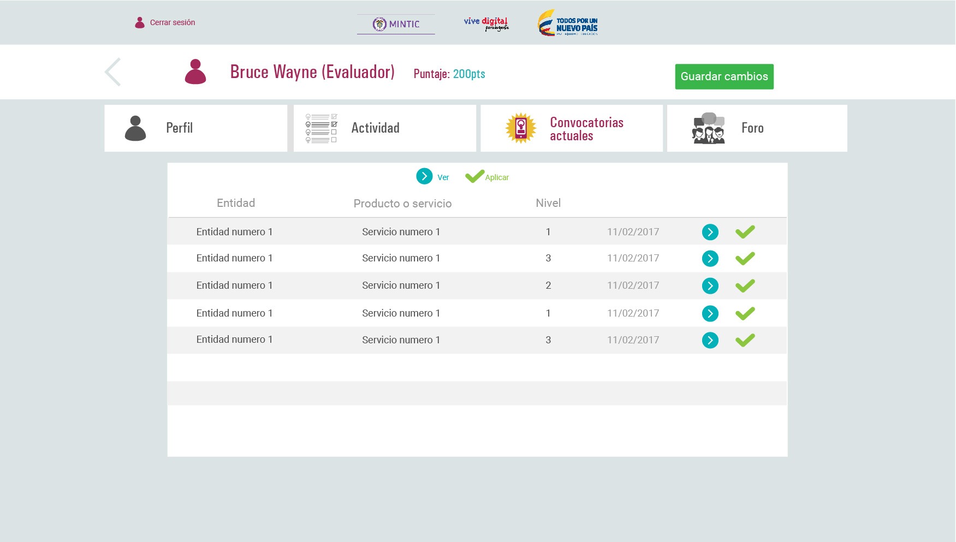
api/service/service?filter_field=current_status&filter_value=1

Slide 16
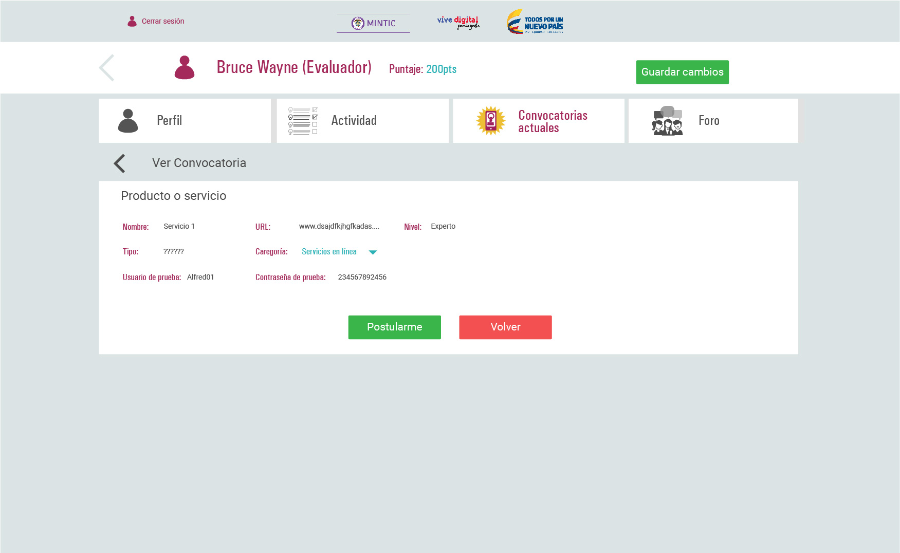
api/question/evaluation_request
{
id_user:{{USER}}
id_service:{{SERVICE}}
Id_user_answer:{{USER_ANSWER}}
id_request_status:4
}

Slide 17
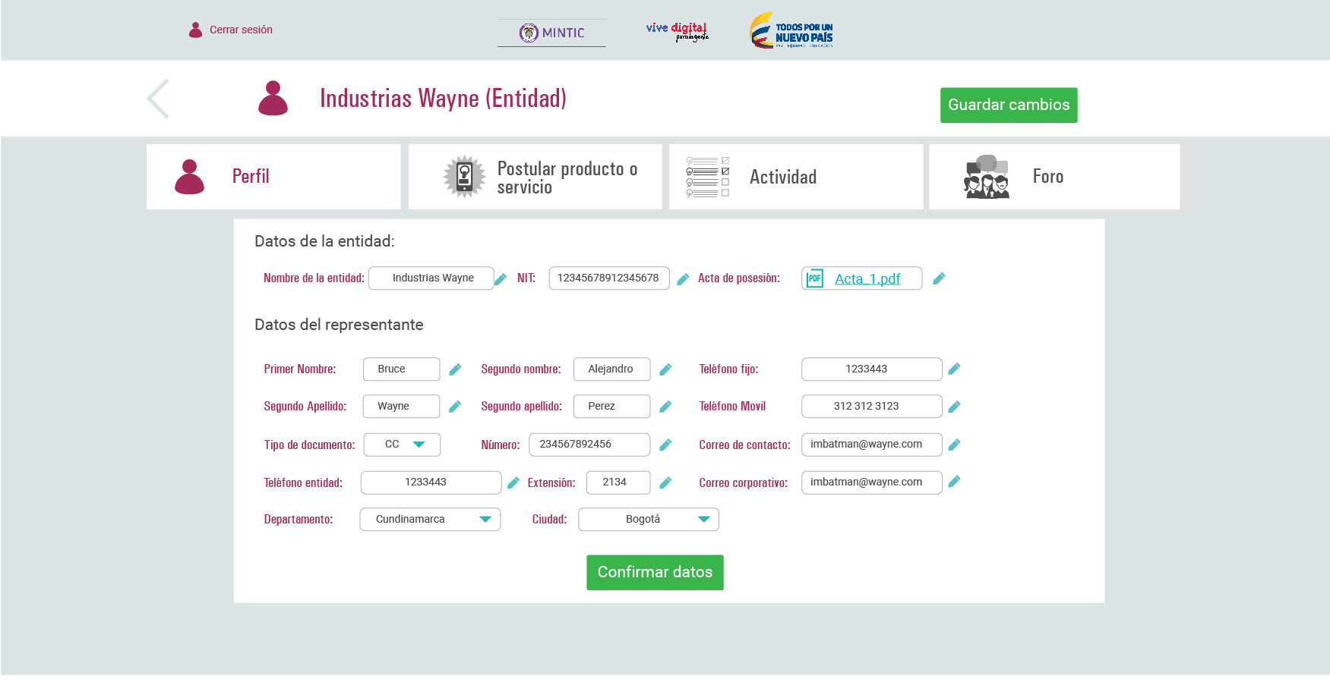
api/place/institution?id={{INSTITUTION}}
Users
api/place/institution_user
api/configuration/user

Slide 18
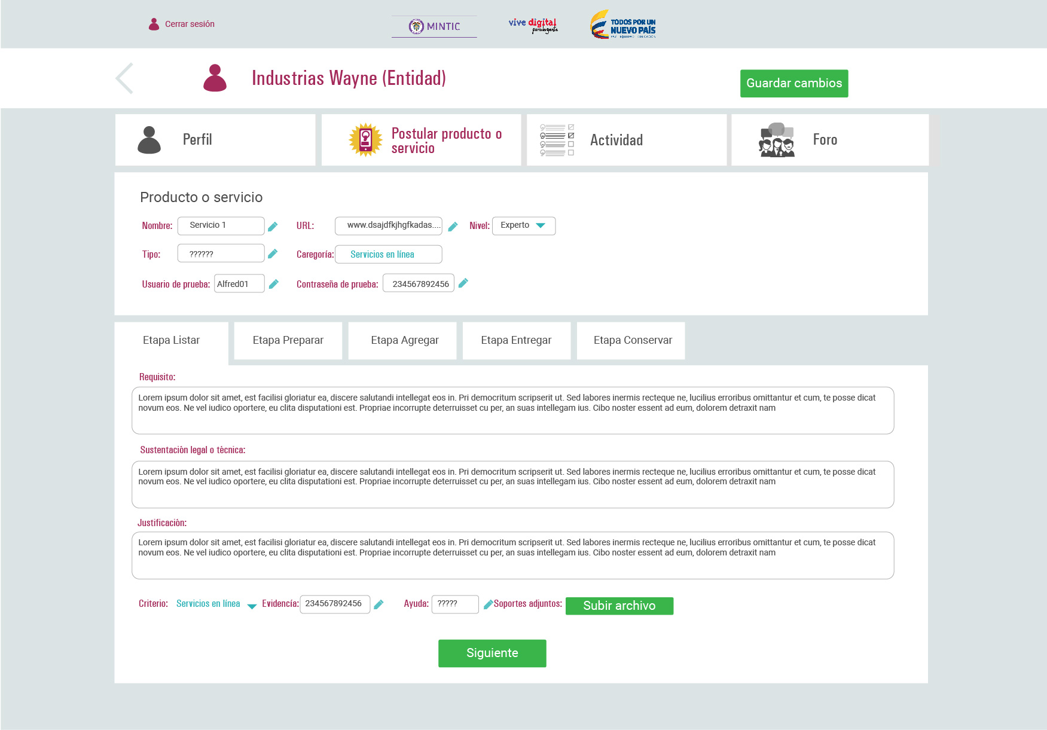
api/service/service
Category
api/question/form?filter_field=id_category&filter_value={{CATEGORY}}
api/question/user_answer
{
id_question:{{question}}
id_service:{{SERVICE}}
id_user:{{USER}}
requisite:{{text}}
support_legal:{{text}}
justification:{{text}}
id_topic:{{TOPIC}}
evidence:{{evidence}}
help:{{help}}
id_media:{{MEDIA}}
}
api/question/media
FormData( media )

Slide 19
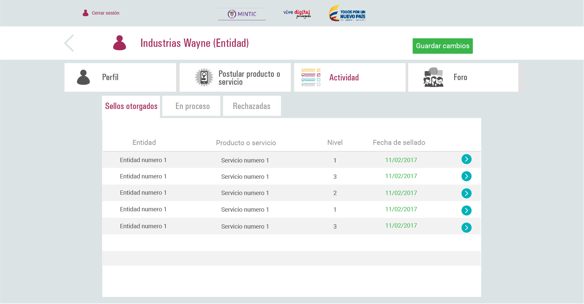
api/service/service?filter_field=current_status&filter_field=id_institution&filter_value=4&filter_value={{INSTITUTION}}

Slide 20
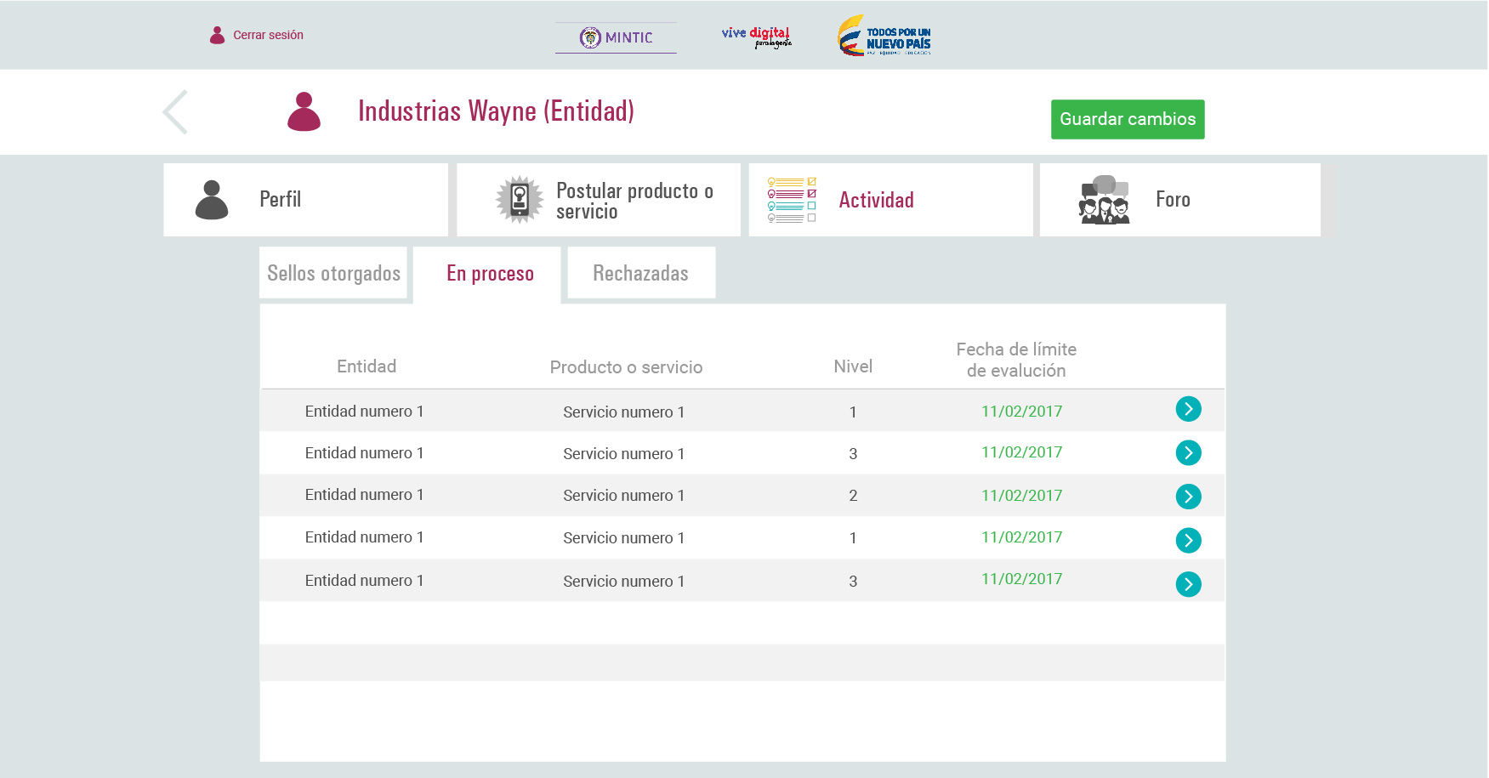
api/service/service?filter_field=current_status&filter_field=id_institution&filter_value=1&filter_value={{INSTITUTION}}

Slide 21
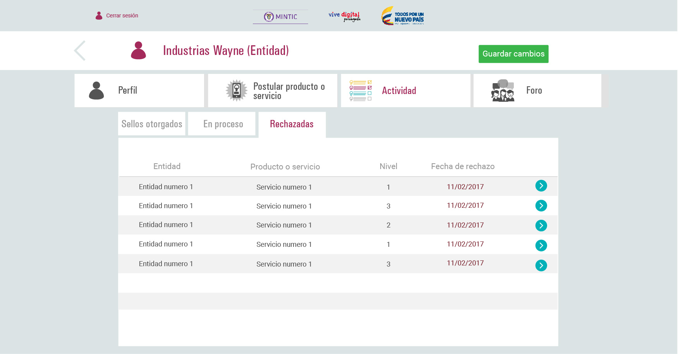
api/service/service?filter_field=current_status&filter_field=id_institution&filter_value=3&filter_value={{INSTITUTION}}

